Slide 1



Slide 2
Autonomous System

Slide 3
RULES
  No side talks
  Phones are in silent mode
  Questions after each slide
  Take permission before leaving
  There will be a break during the session if you want to eat or drink
  Make sure to take notes about what is discussed

Slide 4
Session 6
“Simulation”

Slide 5
About the instructor
Name : zaynab ahamd
Mechatronics lvl 200
Autonomous Subteam Member 2023

Slide 6
What is simulation
Why simulation
Types of simulation
Why ROS
ROS ANATOMY and setup REQUIRED
Simple publisher and subscriber
What is next ?
AGENDA

Slide 7
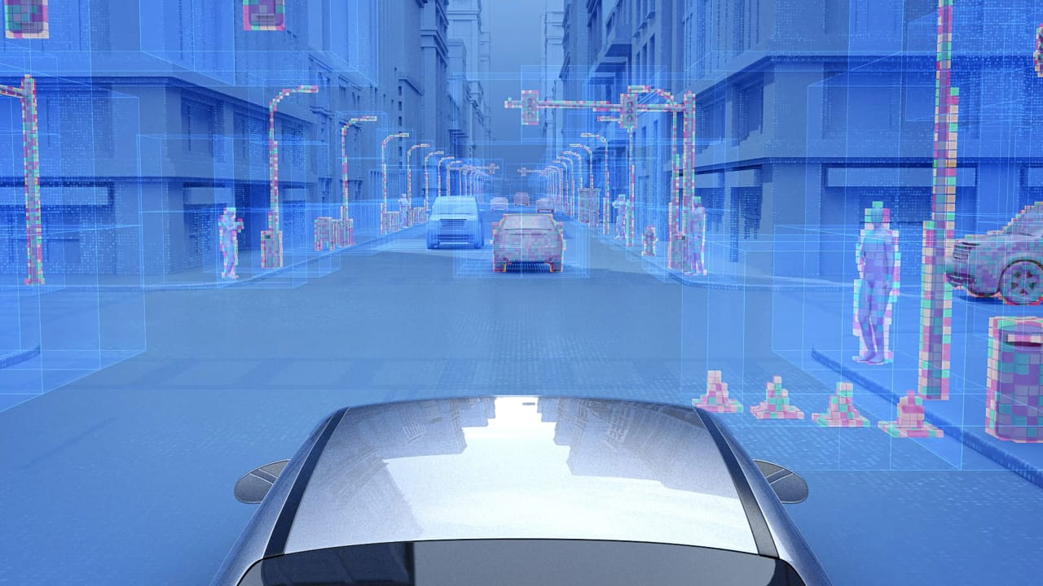
WHAT IS simulation
A Crucial Tool for Safe and Efficient
Development

Slide 8
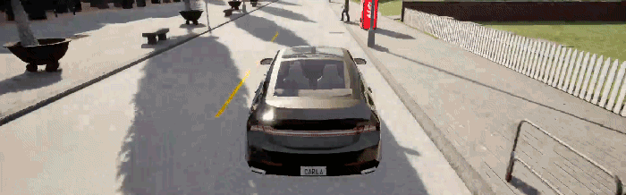
What is simulation
Real world
Model of Real world

Slide 9
SIMULATION
MODELING
EMULATAION

Slide 10
Why simulation
Cost savings
Rapid Prototyping
Avoiding Physical Damage
Unlimited testing environment
Scalability
Reproducibility
Data collection and analysis
Training and education

Slide 11
Simulation
Open loop simulation
Closed loop simulation
Predefined actions
Real time response

Slide 12
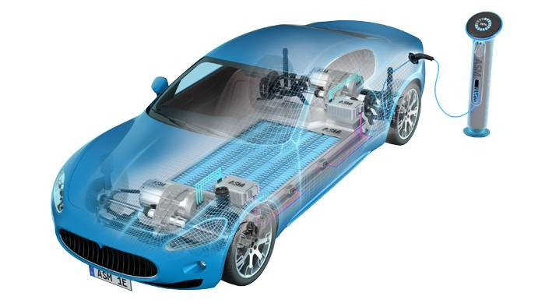
Types of simulations
1.HIL (hardware in loop )
Combines physical hardware with simulated environments
Real hardware components interact with a virtual system
Tools : dSPACE , NI VertiStand ,
OPAL-RT

Slide 13
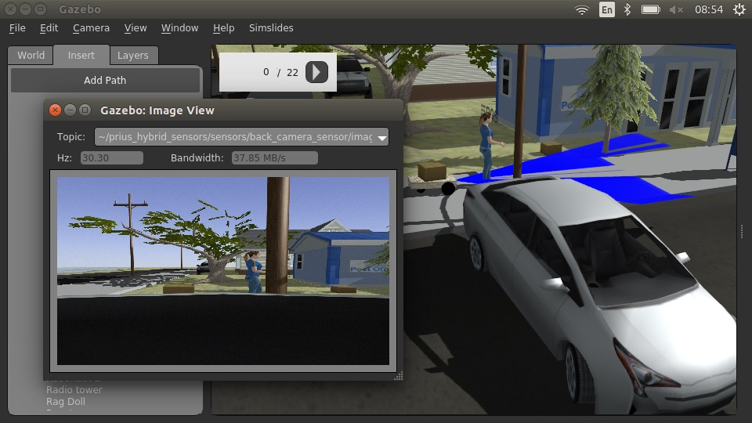
Types of simulations
2.sensor simulation
Help generate data from sensors like LIDAR, radar ,and cameras
We can fine-tune perception algorithms without risking any real-life mishaps
Tools : ROS with gazebo , Autoware , MATLAB/Simulink

Slide 14
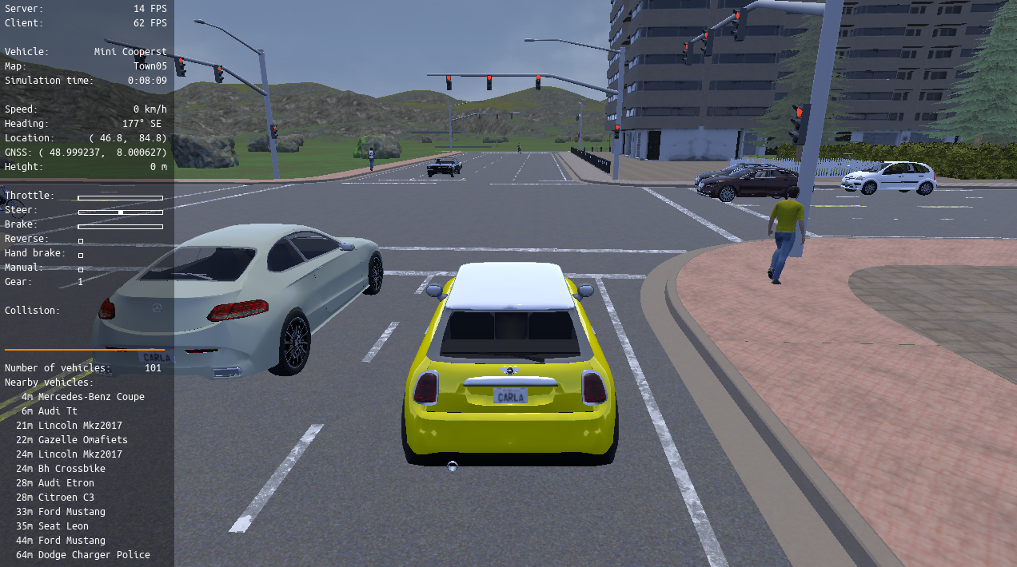
Types of simulations
3.senario simulation
Scenario-based simulation creates predefined driving scenarios to test how self-driving cars react in specific situations, such as lane changes, intersections, or emergencies
Tools : CARLA , NVIDIA DRIVE Sim , and LGSVL

Slide 15
WHY ROS ?
Writing low level code for robotic apps including self driving cars is cumbersome!
Ability to reuse components
Open source
Your app is interfaced with the OS not the hardware
A small core-package , the rest Distrubuted open packages
Growing community
Ros enaples groups of people to work on comlec projects by providing a common and well organized framework, while adding a minimal amount of overhead
Has a rich set of bash commands : roscd , rospack , rosmaek, rosnode , rostopic
Language independence
Easy testing

Slide 16
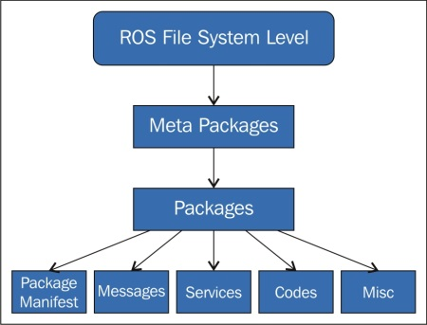
WHY ROS ?
HW abstraction
Filesystem
Libraries and tools
Message passing

Slide 17
Services
Actions
Parameter Server
Bags
Nodes
Topics
Messages
Master

Slide 18
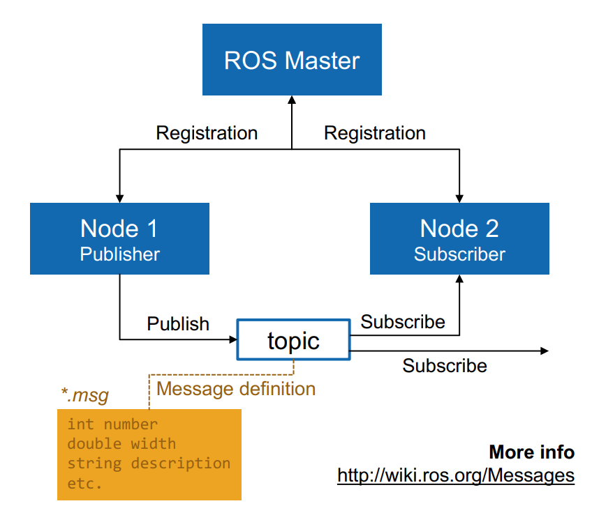
Ros anatomy
roscore
  Every new node register details of the message streams it publishes, and the topics to which it wishes to subscribe
  Provides each node with the information that is needed for communication
Provides a parameter server, which is used for configurations

Slide 19
ROS ANATOMY
Catkin
  ROS build system: the set of tools that ROS uses to generate executable programs, libraries, scripts, and interfaces that other code can use
Workspace
  The same as a project folder in C/C++
  Contains src, devel, build folders
  src folder contains the packages and the CMakeLists.txt (toplevel cmake)
ROS Package
  Used for organization purposes, each of which contains some combination of code, data, and documentation
  Contains src folder, which holds the code
Contains package.xml, and CMakeLists.txt ins package.xml, and CMakeLists.txt

Slide 20
ROS ANATOMY
RECAP
roscore: “coordinator”
Catkin: ros build tools
Devel: setup.bash (Environment variables)
Build: binaries and executables
CMakeLists.txt: Dependencies
package.xml: Package metadata and documentation

Slide 21
ROS SETUP
Create a new directory
mkdir -p ~/catkin_ws/src
Open src folder
cd ~/catkin_ws/src/
Make a catkin workspace
catkin_init_workspace
return to catkin_ws
cd ~/catkin_ws
build the workspace (Adds devel and build folders)
catkin_make
Apply the environment variables from /devel/setup.bash
source devel/setup.bash

Slide 22
Workspace SETUP
Open src folder cd ~/catkin_ws/src
Creating a new package catkin_create_pkg my_pkg rospy

Slide 23
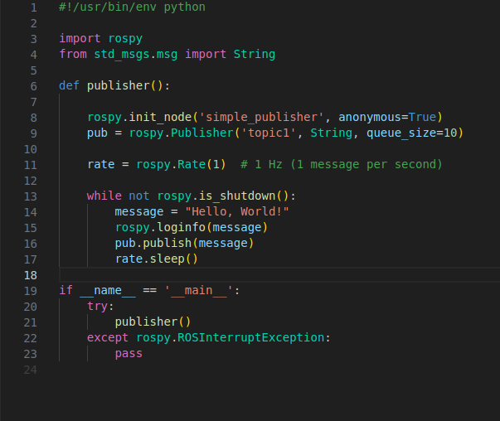
Simple publisher

Slide 24
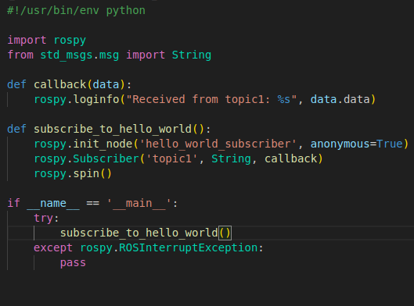
Simple subscriber

Slide 25
WHAT IS NEXT ?

